Slide 1
Installing git

Slide 2
Installing Git
Before you start using Git, you have to make it available on your computer.
Even if it’s already installed, it’s probably a good idea to update to the latest version.
You can either install it as a package or via another installer, or download the source code and compile it yourself.

Slide 3
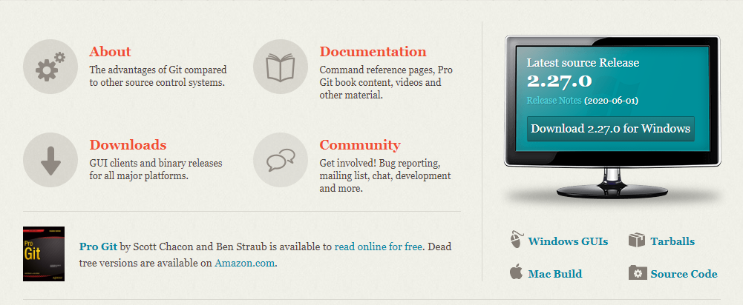
Installing Git (continued)
Installing on Windows
The most official build is available for download on the Git website. Just go to https://git-scm.com/download/win and the download will start automatically.

Slide 4
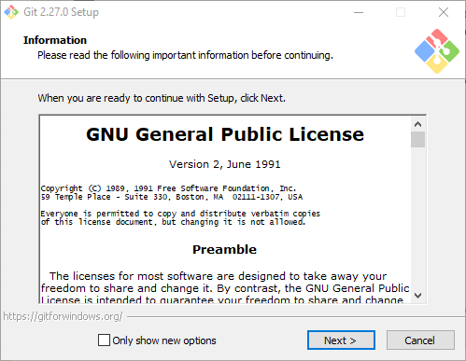
Installing Git (continued)

Slide 5
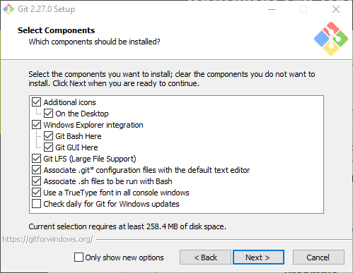
Installing Git (continued)

Slide 6
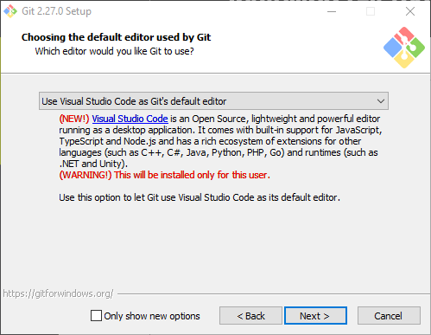
Installing Git (continued)
We recommend using Visual Studio Code as Git’s default editor

Slide 7
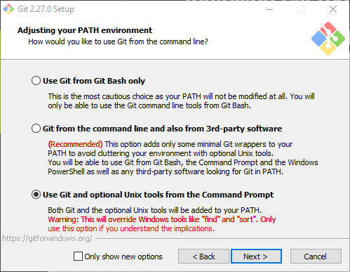
Installing Git (continued)

Slide 8
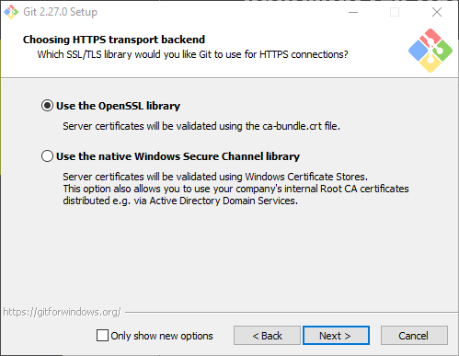
Installing Git (continued)

Slide 9
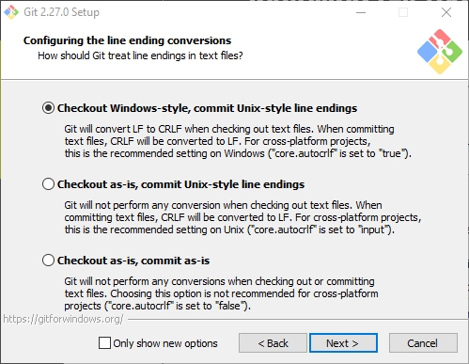
Installing Git (continued)

Slide 10
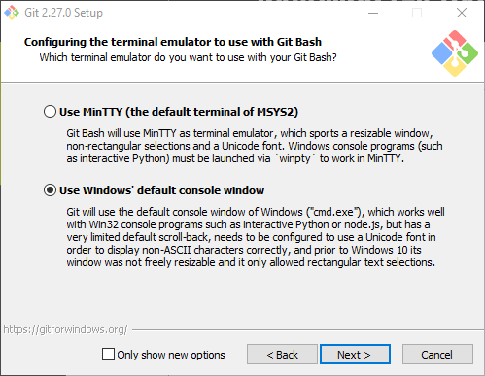
Installing Git (continued)

Slide 11
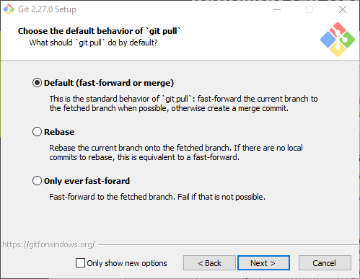
Installing Git (continued)

Slide 12
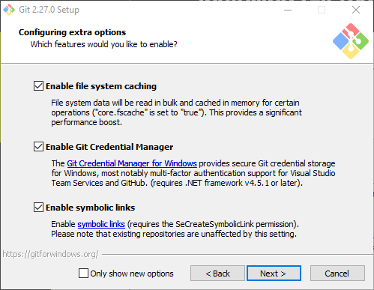
Installing Git (continued)

Slide 13
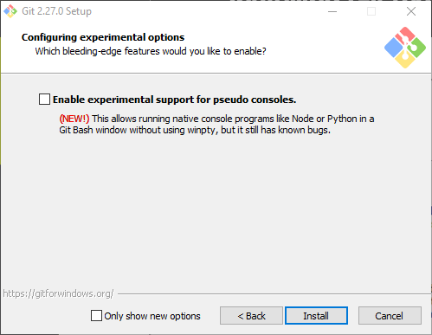
Installing Git (continued)

Slide 14
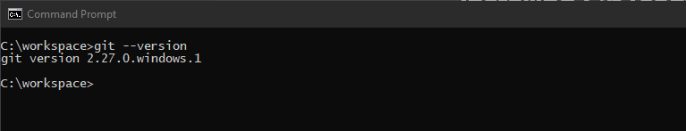
Installing Git (continued)
Verify your installation by opening a command prompt.
Enter the command: git --version and press enter

Slide 15
First Time Git Setup
Your Identity
The first thing you should do when you install Git is to set your user name and email address.
This is important because every Git commit uses this information, and it’s immutably baked into the commits you start creating.
Open a command prompt and enter your information:
The email address you enter should be the same one that you will use to register for a new GitHub account.

Slide 16
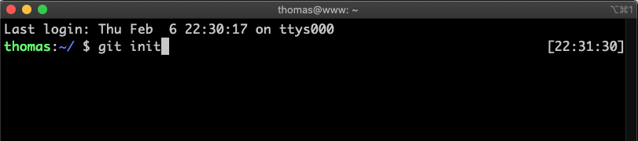
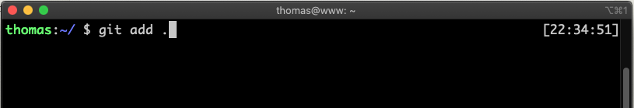
Git Basics
Step 1. Navigate to your project folder on your computer
Step 2. Initialize your local git repo by typing git init
Step 3. add all your files to the staging area by typing git add .

Slide 17
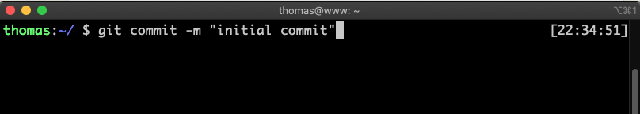
Git Basics (continued)
Step 4. Create your first commit by typing git commit –m “initial commit”

Slide 18
Navigating GitHub
Version control with Git takes on a distributed nature.
The code resides on each local computer where the code base is being worked on, as well as on a central remote point where every individual who wishes to work on the code base can obtain it.
GitHub is one such central remote point.
GitHub hosts repositories and enables users to obtain, alter, and integrate changes to a code base through Git:

